Slide 1
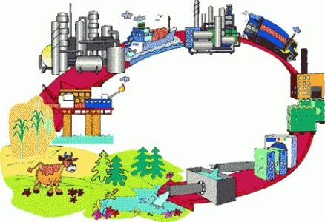
Metabolic Diseases Lesson 1.2
The industrial food chain:
What’s in your food besides food?

Slide 2
Do Now
Work in groups to brainstorm the food additives in the following categories:
Preservatives
Nutrients
Hormones
Pesticides
Antibiotics

Slide 3
Do Now
Preservatives | Nutrients | Hormones | Antibiotics | Pesticides

Slide 4
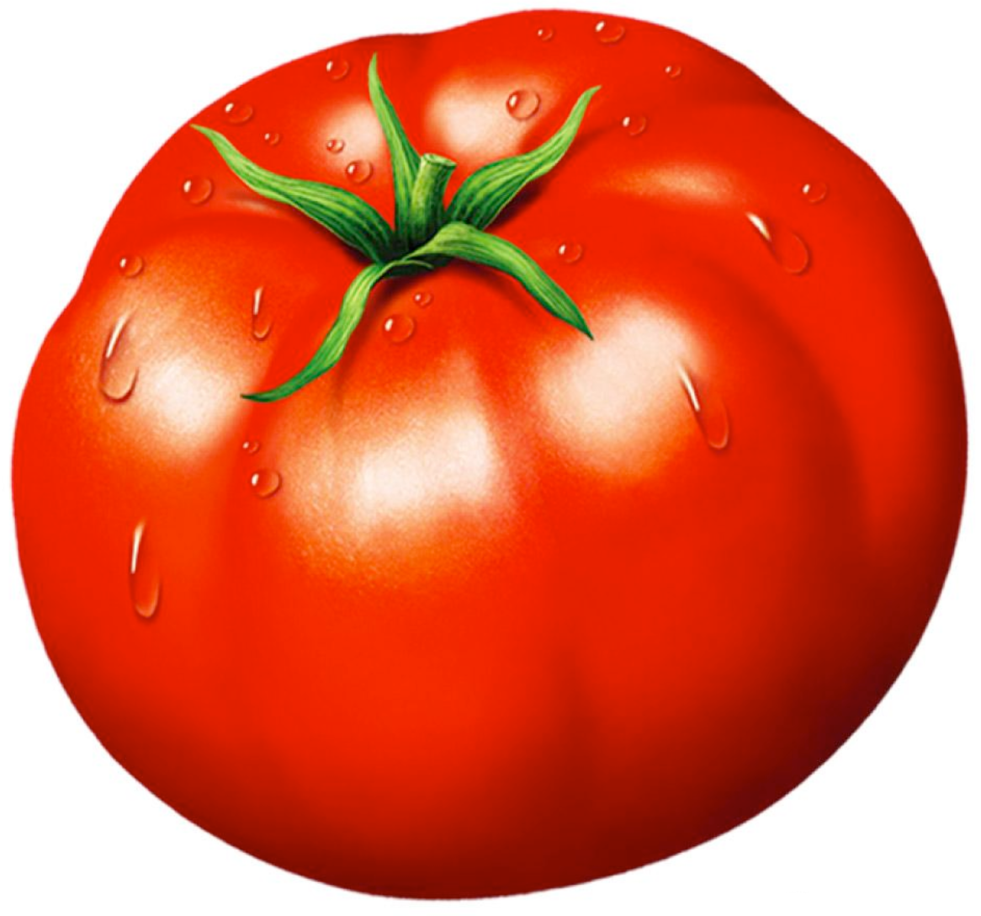
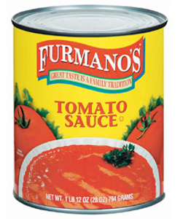
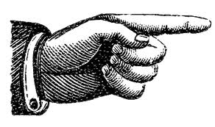
Activity: Food Additive Matching Game
Divide into teams of five
The game will consist of five rounds.
For each round, one member of the team will come to the board to identify which foods contain specific additives.

Slide 5
TEAM MEMBER AT THE BOARD:
Identify all of the foods that contain the additive listed.
If you do not correctly identify all of the foods, try again until you get them all right.
The first team representative to choose the correct set of foods scores a point for their team.
TEAM MEMBERS NOT AT THE BOARD:
Make a list of the foods that contain the additives.

Slide 6
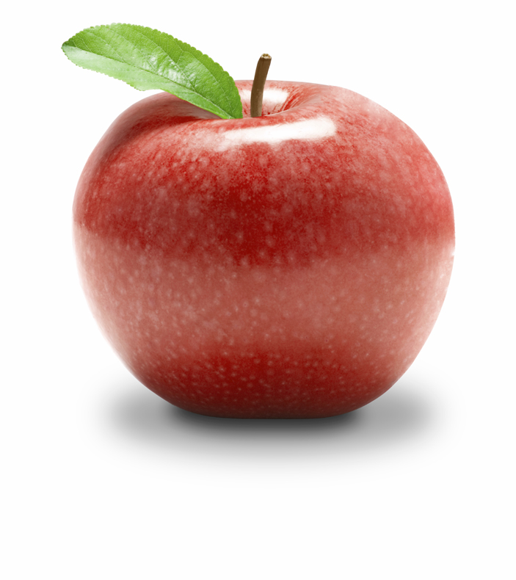
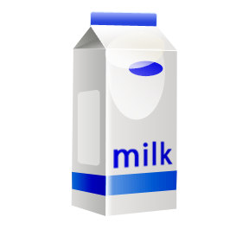
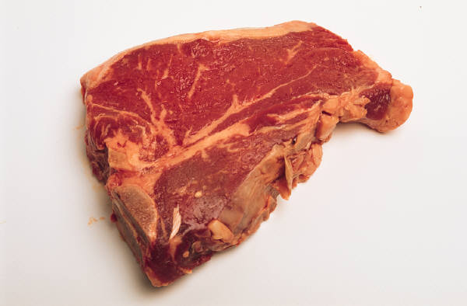
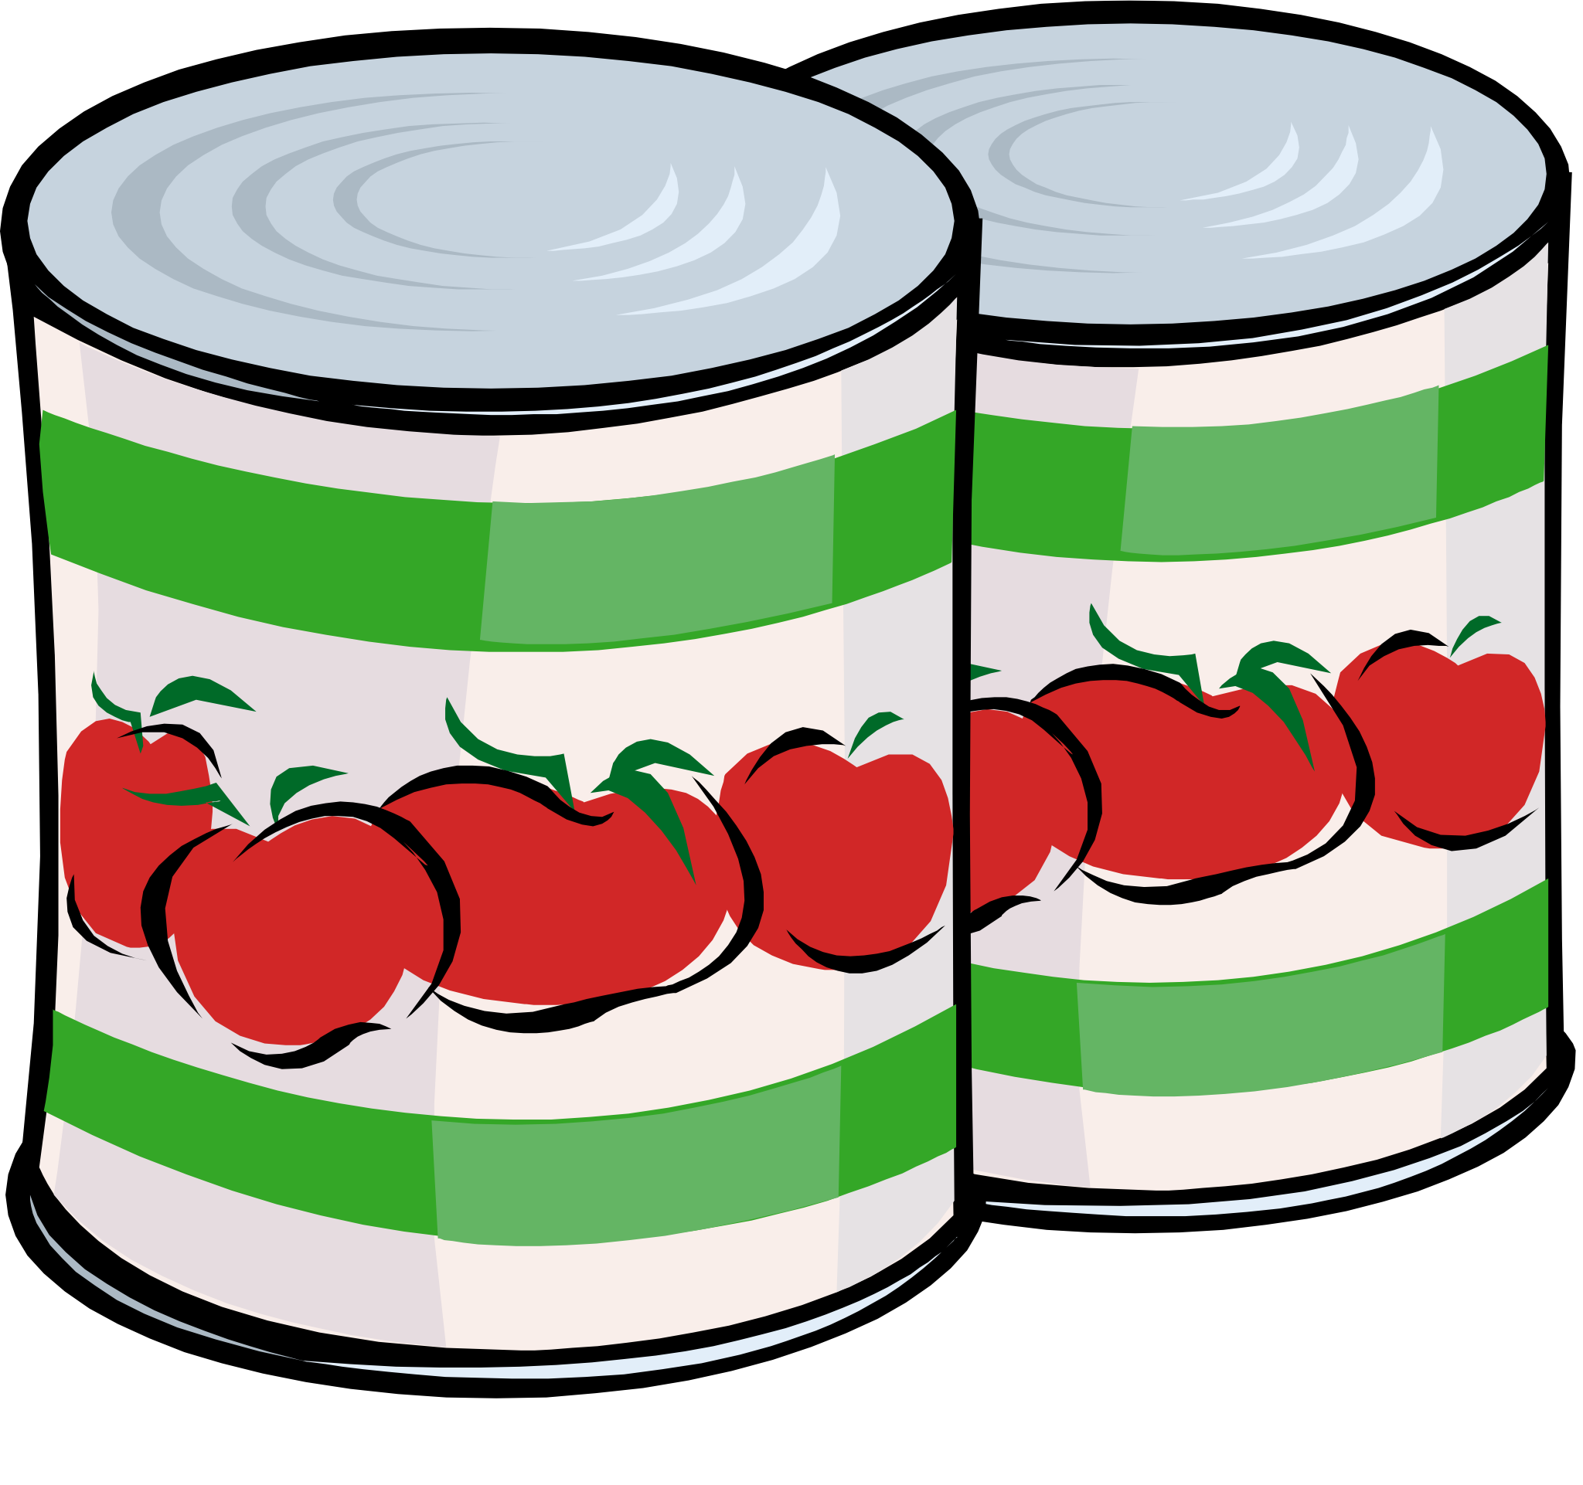
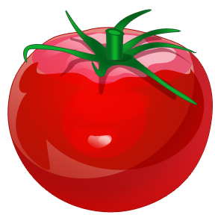
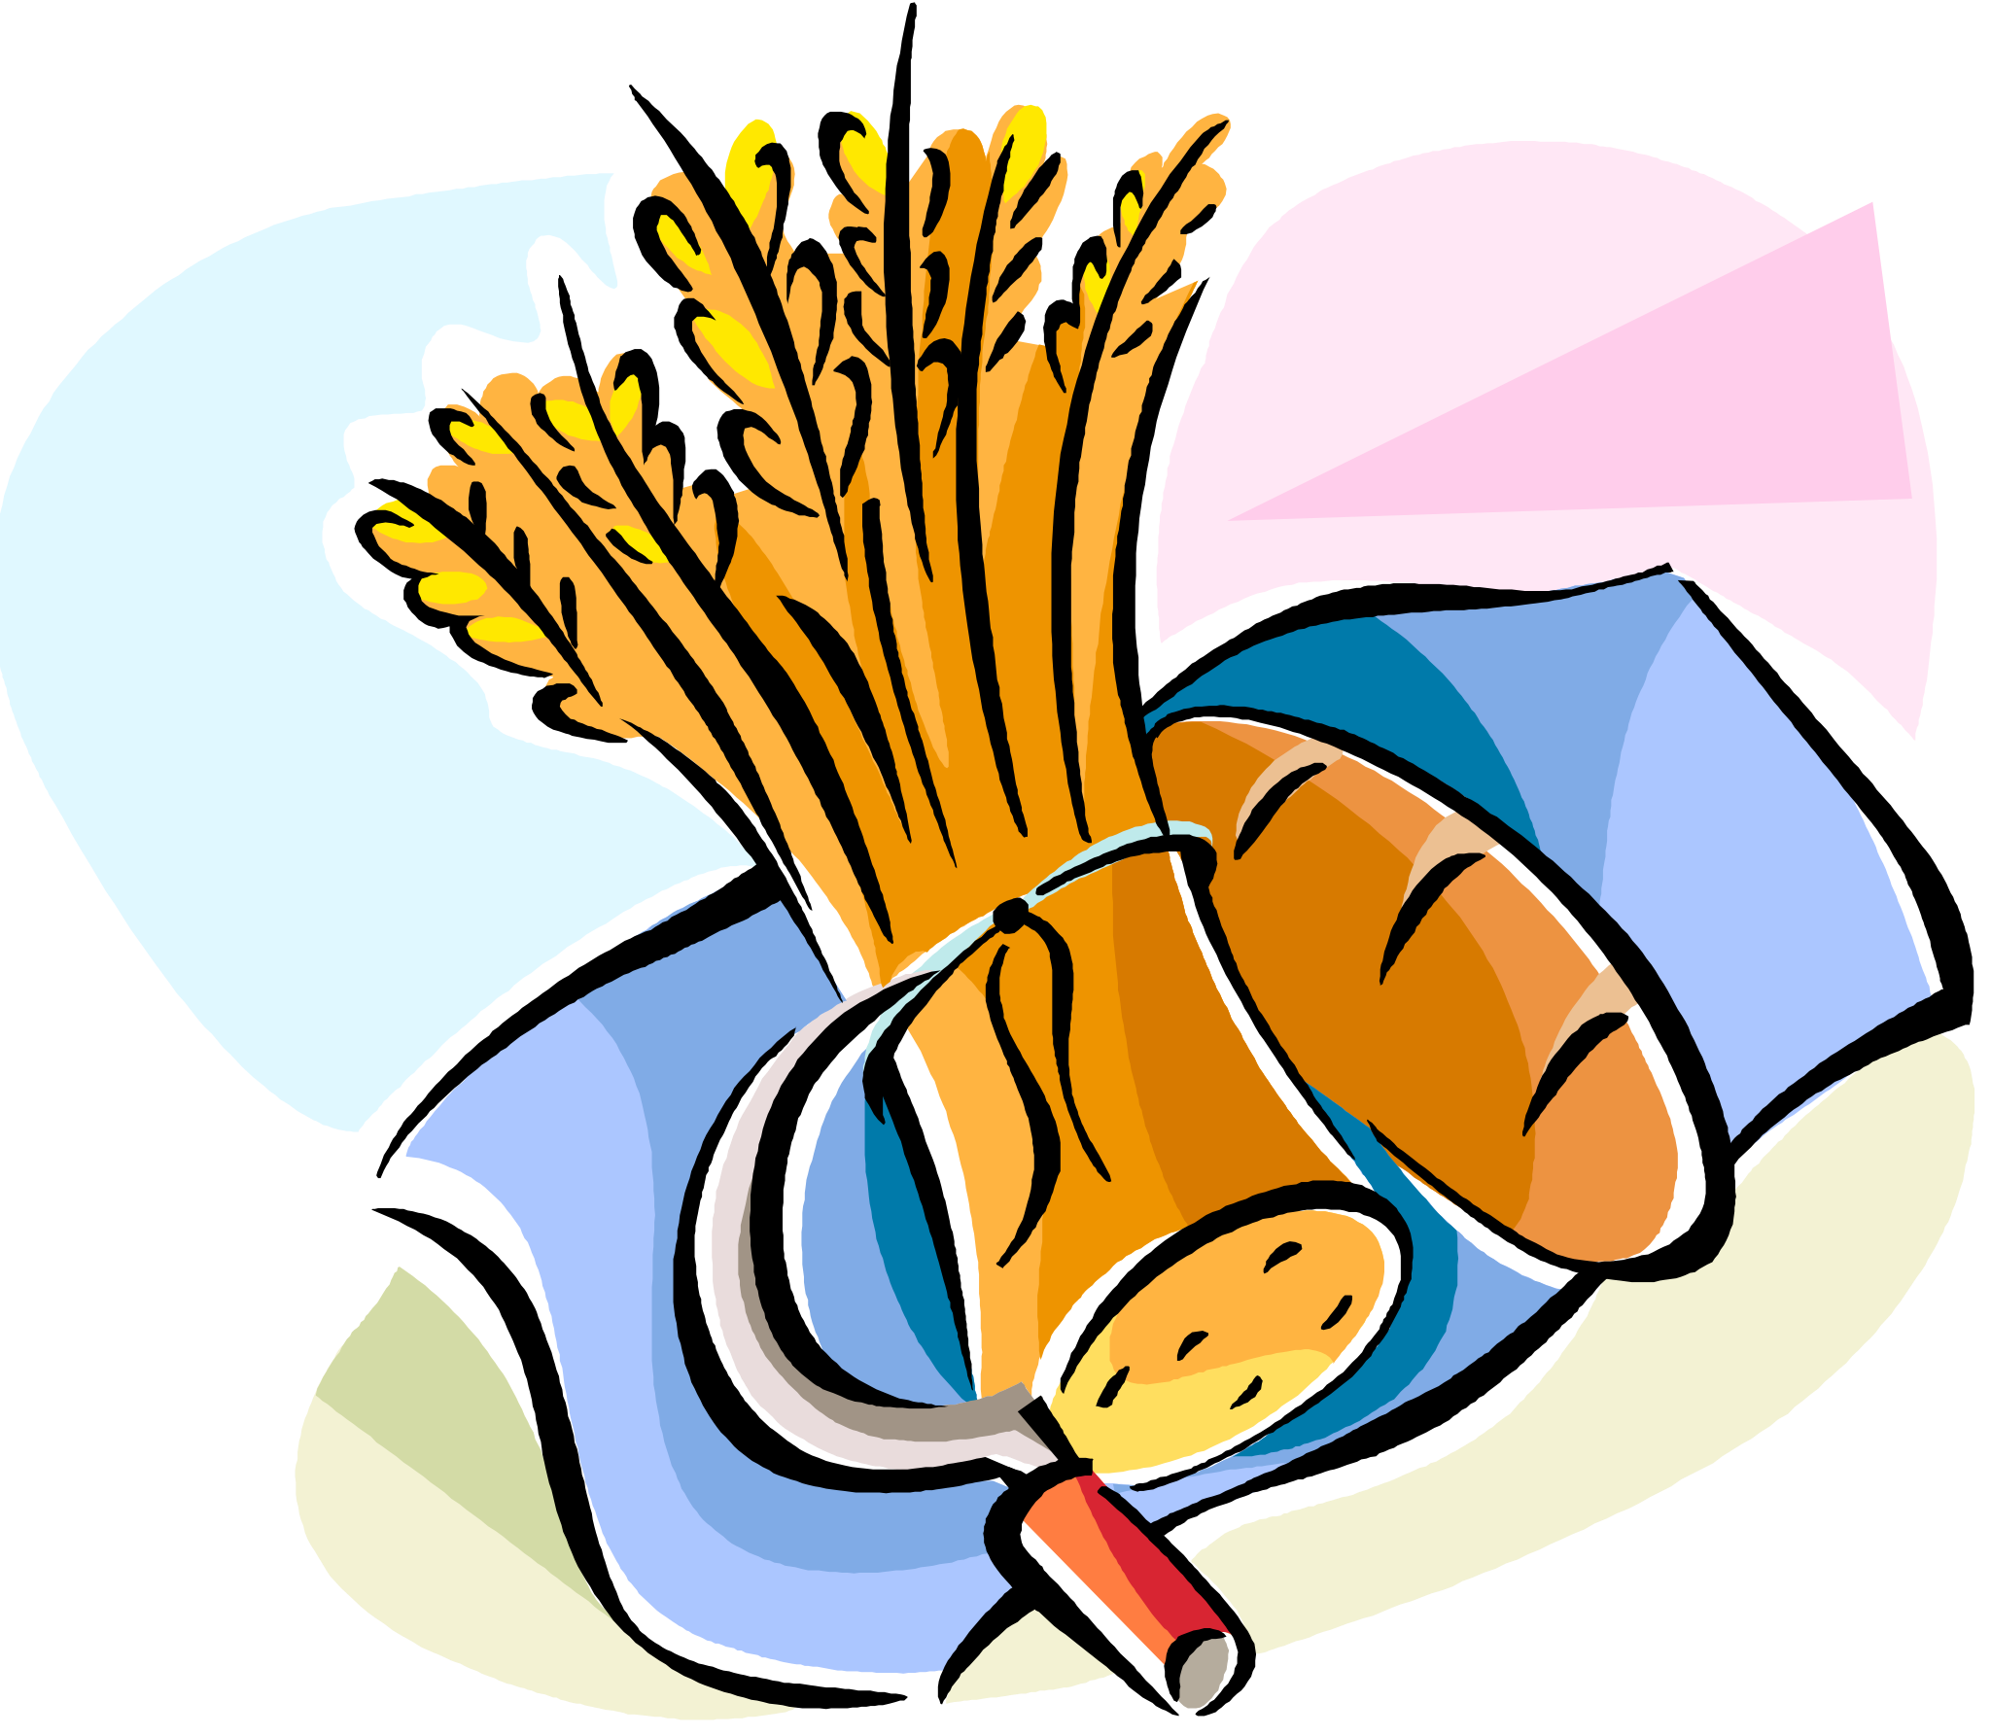
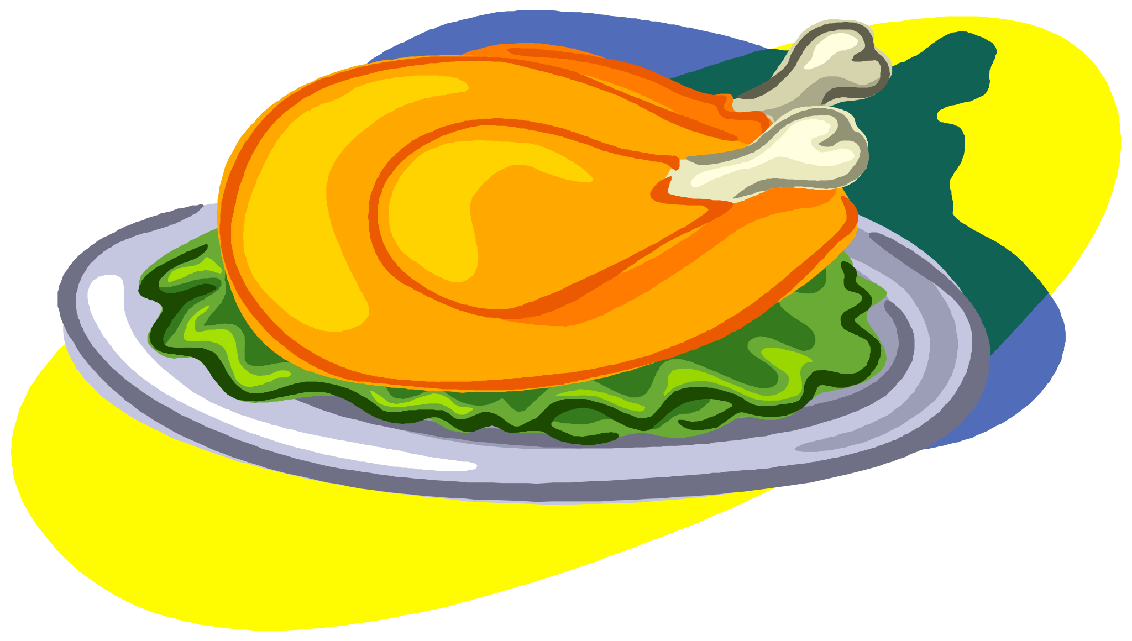
Pesticide: Chemical used to prevent insects, fungi, or weeds from destroying a food crop
CANNED TUNA
WHEAT
Which foods may contain Pesticides?
Notes:
ROUND 1: A, B, E, F, I

Slide 7
Pesticide: Chemical used to prevent insects, fungi, or weeds from destroying a food crop
CANNED TUNA
WHEAT
Which foods may contain Pesticides?
Notes:
ROUND 1: A, B, E, F, I

Slide 8
Hormone: Chemical added to regulate the growth of a food source
CANNED TUNA
WHEAT
Which foods may contain Hormones?
Notes:
ROUND 2: C, D, G, H

Slide 9
Hormone: Chemical added to regulate the growth of a food source
CANNED TUNA
WHEAT
Which foods may contain Hormones?
Notes:
ROUND 3: C, D, G, H

Slide 10
GMO (Genetically Modified Organisms): A food whose DNA has been changed to improve its performance
CANNED TUNA
WHEAT
Which foods may contain GMOs?
Notes:
ROUND 3: B, E, F, I

Slide 11
GMO (Genetically Modified Organisms): A food whose DNA has been changed to improve its performance
CANNED TUNA
WHEAT
Which foods may contain Hormones?
Notes:
Most corn and wheat are genetically modified in the US. Tomatoes used to be modified, but GMO tomatoes are no longer produced.

Slide 12
Antibiotic: Chemical added to prevent disease in animals living in crowded conditions or to increase rate of growth
CANNED TUNA
WHEAT
Which THREE foods may contain Antibiotics?
Notes:
ROUND 4: C, D, G

Slide 13
Antibiotic: Chemical added to prevent disease in animals living in crowded conditions or to increase rate of growth
CANNED TUNA
WHEAT
Which THREE foods may contain Antibiotics?
Notes:
ROUND 4: C, D, G

Slide 14
Other Food Additives: Chemicals added to make a food last longer be more nutritious or taste and look better,
CANNED TUNA
WHEAT
Which foods may contain other Additives?
Notes:
ROUND 5: A (wax), C (vitamin D), E (BPA), H (mercury)

Slide 15
Other Food Additives: Chemicals added to make a food last longer be more nutritious or taste and look better,
CANNED TUNA
WHEAT
Which foods may contain other Additives?
Notes:
ROUND 5: A (wax), C (vitamin D), E (BPA), H (mercury – although this is actually a contaminant, or unintentional additive)

Slide 16
ANSWER KEY
Pesticides: A, B, E, F, I
Hormones: C, D, G
GMO: B, E, F, I
Antibiotic: C, D, G
Additives: A (wax), C (vitamins), E (BPA), H (mercury)

Slide 17
Discussion/Debrief
Which additives are used to affect the food’s yield, shelf life or nutrition?
Which additives are used to affect the food’s taste and looks?

Slide 18
Discussion/Debrief
Which additives are used to affect the food’s yield, shelf life or nutrition?
Increase yields (pesticides, antibiotics, hormones, GMO)
Increase shelf life (preservatives)
improve nutritive value (nutrients)
Which additives are used to affect the food’s taste and looks?
Improve taste (sweeteners, salt, MSG)
Improve looks (food colors)

Slide 19
The major food additives that extend shelf life are:
Class | Main Attributes | Health Risks
Stabilizers and thickeners: Pectins, gums, gelatins, and agars | Gives a smooth texture and uniform color | No known health risks
Sequestrants: EDTA and citric acid | Preserve food containing fats | No known health risks
Curing and pickling agents: Salt, nitrates, and nitrites | Prevent growth of bacteria, especially botulinum | Should be avoided during pregnancy

Slide 20
The major food additives that add or substitute nutrients are:
Class | Main Attributes | Health Risks
Nutrient supplements: Vitamin A and D | Enhance nutrient content of food | No known health risks

Slide 21
The major food additives that improve taste and looks are:
Class | Main Attributes | Health Risks
Emulsifiers: Monoglycerides and lectins | Suspends fats in water | No known health risks
Alternative sweeteners: Aspartame and sucralose | Sweetens without adding calories | Moderate use has no proven health risks
Color additives: Tartrazine | Color additives: Tartrazine | May cause hives and drippy nose
Flavor enhancers: MSG (monosodium glutamate) and salt | Brings out the natural flavors in food | In sensitive people may cause dizziness, sweating and headaches.

Slide 22
Wrap Up
Are additives good or bad?
Is the answer to this question the same for all people?

Slide 23
Homework
Take on the perspective of one stakeholder from the list below, and answer the questions.
Parent
Restaurant owner
Farmer (local)
Farmer from a major corporation
Manufacturer
FDA

